Slide 1
Modern Systems Analysis and Design Fifth Edition
Chapter 3
Analysis
Determining System Requirements
6.1

Slide 2
Learning Objectives
Describe options for designing and conducting interviews and develop a plan for conducting an interview to determine system requirements
Design, distribute, and analyze questionnaires to determine system requirements
Explain advantages and pitfalls of observing workers and analyzing business documents to determine requirements
6.2

Slide 3
Learning Objectives
Explain how computing can provide support for requirements determination
Learn about Joint Application Design (JAD)
Use prototyping during requirements determination
Select the appropriate methods to elicit system requirements
6.3

Slide 4
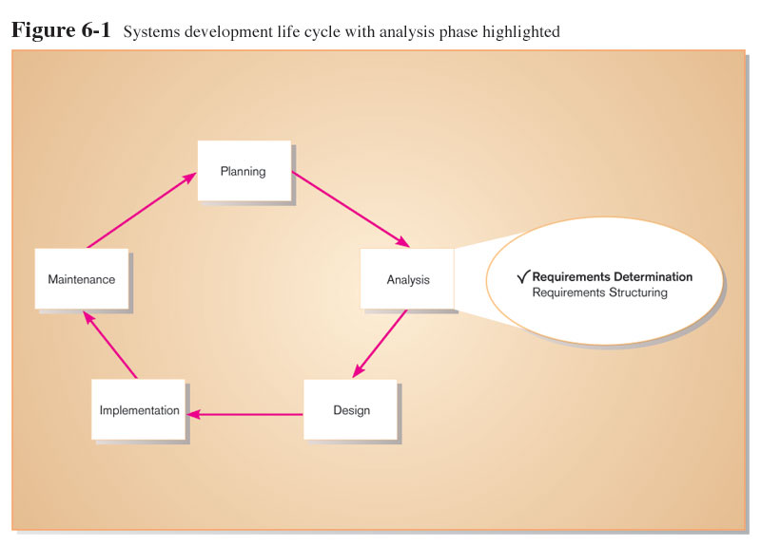
Performing Requirements Determination

Slide 5
Performing Requirements Determination
Gather information on what system should do from many sources
Users
Reports
Forms
Procedures
6.5

Slide 6
Performing Requirements Determination
Characteristics for gathering requirements
Impertinence
Question everything
Impartiality
Find the best organizational solution
Relaxation of constraints, assume anything is possible
Attention to detail, every fact must fit with every other fact
Reframing
View the organization in new ways,
6.6

Slide 7
Deliverables and Outcomes
Types of deliverables:
From interviews and observations - interview transcript observation notes, meeting minutes
From existing written documents - mission and strategy statements, business forms, procedure manuals, job descriptions, training manuals, system documentation, flowcharts
From computerized sources – Joint Application Design session results, CASE repositories, reports from existing systems, displays and reports from system prototype.
Information collected from users
Existing documents and files
Computer-based information
Understanding of organizational components
Business objective
Information needs
Rules of data processing
Key events
6.7

Slide 8
Traditional Methods for Determining Requirements
Interviewing and Listening
Gather facts, opinions and speculations
Observe body language and emotions
Guidelines
Plan
Checklist
Appointment
Be neutral
Listen
Seek a diverse view
6.8

Slide 9
Traditional Methods for Determining Requirements
Interviewing (Continued)
Interview Questions
Open-Ended
No pre-specified answers
Close-Ended
Respondent is asked to choose from a set of specified responses
Additional Guidelines
Do not phrase questions in ways that imply a wrong or right answer
Listen very carefully to what is being said
Type up notes within 48 hours
Do not set expectations about the new system
6.9

Slide 10
Traditional Methods for Determining Requirements
Administering Questionnaires
More cost-effective than interviews
Choosing respondents
Should be representative of all users
Types of samples
Convenient, local site.
Random sample
Purposeful sample, people who satisfy certain criteria.
Stratified sample, random set of people from many hierarchical levels.
6.10

Slide 11
Traditional Methods for Determining Requirements
Questionnaires
Design
Mostly closed-ended questions
Can be administered over the phone or in person
Vs. Interviews
Interviews cost more but yield more information
Questionnaires are more cost-effective
See table 7-4 for a complete comparison
6.11

Slide 12
Traditional Methods for Determining Requirements
Interviewing Groups
Advantages
More effective use of time
Enables people to hear opinions of others and to agree or disagree
Disadvantages
Difficulty in scheduling
Nominal Group Technique (NGT) A facilitated process that supports idea generation by groups.
Process
Members come together as a group, but initially work separately.
Each person writes ideas.
Facilitator reads ideas out loud, and they are written on a blackboard or flipchart.
Group openly discusses the ideas for clarification.
Ideas are prioritized, combined, selected, reduced.
6.12

Slide 13
Traditional Methods for Determining Requirements
Directly Observing Users
Watching users do their jobs
Obtaining more firsthand and objective measures of employee interaction with information systems.
Can cause people to change their normal operating behavior.
Time-consuming and limited time to observe.
6.13

Slide 14
Analyzing Procedures and Other Documents
Types of information to be discovered when analyzing a document:
Problems with existing system
Opportunity to meet new need
Organizational direction
Names of key individuals
Values of organization
Special information processing circumstances
Reasons for current system design
Rules for processing data
6.14

Slide 15
Analyzing Procedures and Other Documents
Four types of useful documents to SA:
Written work procedures
For an individual or work group.
Describes how a particular job or task is performed.
Includes data and information used and created in the process
Business form
Explicitly indicate data flow in or out of a system
Report generated by current systems
Enables the analyst to work backwards from the report to the data that generated it
Description of current information system, how they were designed and how they work
6.15

Slide 16
Forma and Informal system
Formal Systems: the official way a system works as described in organizational documentation (i.e. work procedure).
Informal Systems: the way a system actually works (i.e. interviews, observations).

Slide 17
Modern Methods for Determining Requirements
Joint Application Design (JAD)
Brings together key users, managers and systems analysts
Purpose: collect system requirements simultaneously from key people
Conducted off-site
Prototyping
Repetitive process
Basic version of system is built
Refine understanding of system requirements in concrete terms.
Goal: to develop concrete specifications for ultimate system
6.17

Slide 18
Joint Application Design (JAD)
Intensive group-oriented requirements determination technique.
Team members meet in isolation for an extended period of time.
Highly focused.
Resource intensive.
Started by IBM in 1970s.
6.18

Slide 19
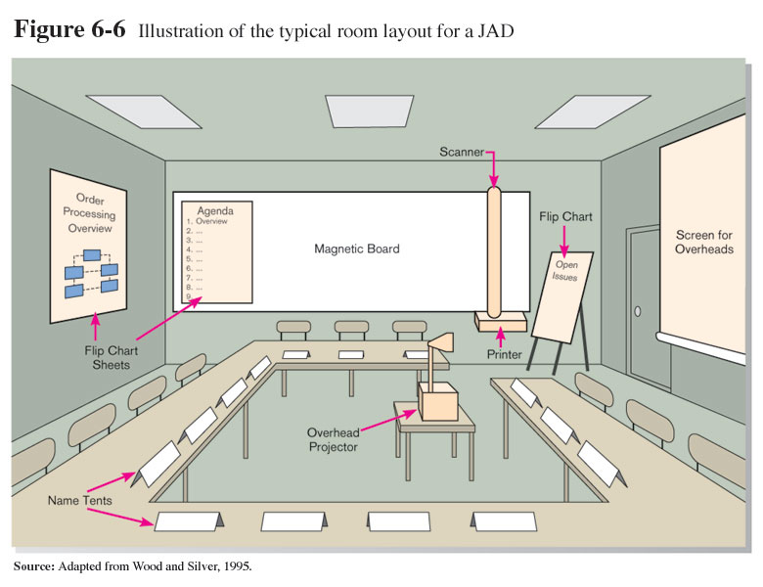
JAD

Slide 20
JAD
JAD Participants:
Session Leader: facilitates group process.
Users: active, speaking participants
Managers: active, speaking participants
Sponsor: high-level champion, limited participation.
Systems Analysts: should mostly listen.
Scribe: record session activities.
IS Staff: should mostly listen.
End Result
Documentation detailing existing system.
Features of proposed system.

Slide 21
Joint Application Design (JAD)
CASE Tools During JAD
Upper CASE tools are used
Enables analysts to enter system models directly into CASE during the JAD session
Screen designs and prototyping can be done during JAD and shown to users
6.21

Slide 22
Joint Application Design (JAD)
Supporting JAD with GSS
Group support systems (GSS) can be used to enable more participation by group members in JAD
Facilitate sharing of ideas and voicing of opinions about system requirements.
Members type their answers into the computer
All members of the group see what other members have been typing
6.22

Slide 23
Prototyping
Quickly converts requirements to working version of system.
Once the user sees requirements converted to system, will ask for modifications or will generate additional requests.
Most useful when:
User requests are not clear
Few users are involved in the system
Designs are complex and require concrete form
History of communication problems between analysts and users
Tools are readily available to build prototype
6.23

Slide 24
Prototyping
Drawbacks
Tendency to avoid formal documentation
Difficult to adapt to more general user audience
Sharing data with other systems is often not considered
Systems Development Life Cycle (SDLC) checks are often bypassed
6.24

Slide 25
Business Process Reengineering (BPR)
Search for and implementation of radical change in business processes to achieve breakthrough improvements in products and services
Goals
Reorganize complete flow of data in major sections of an organization.
Eliminate unnecessary steps.
Become more responsive to future change.
Combine steps
6.25

Slide 26
Business Process Reengineering (BPR)
Identification of processes to Reengineer
Key business processes
Set of activities designed to produce specific output for a particular customer or market
Focused on customers and outcome
Key business process includes all activities of design, build, deliver and support a product.
6.26

Slide 27
Business Process Reengineering (BPR)
Identify specific activities that can be improved through BPR, once it have been identified, Information Technology must be applied to radically improve business process.
Disruptive technologies
are technologies that enable the breaking of long-held business rules that inhibit organizations from making radical business changes. (decision support tools, wireless data communication, high performance computing can provide real-time updating)
See table 6-6. More Examples.
6.27

Slide 28
Requirements determining using Agile Methodologies
Continual user involvement
Replace traditional SDLC waterfall with iterative analyze – design – code – test cycle
Agile usage-centered design
Focuses on user goals, roles, and tasks
Gather a group of people all stakeholders in one room.
Give everyone a chance to talk about current and new system.
Determine user roles and goals
Determine task needs to be completed to achieve the goal.
Task cards will be grouped together based on similarity.
For each task, list steps that are necessary to complete the step.
Treat each set of tasks to be supported by a single aspect of user interface (partition task)
Prototype and refine the prototype
The Planning Game
Based on eXtreme programming
Exploration, steering, commitment
7.28

Slide 29
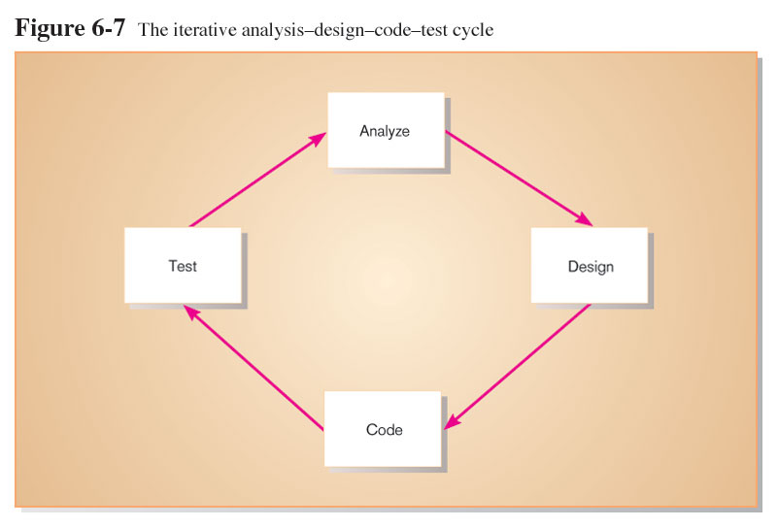
Continual User Involvement

Slide 30
Agile Usage-Centered Design Steps
Gather group of programmers, analysts, users, testers, facilitator.
Document complaints of current system.
Determine important user roles.
Determine, prioritize, and describe tasks for each user role.
Group similar tasks into interaction contexts.
Associate each interaction context with a user interface for the system, and prototype the interaction context.
Step through and modify the prototype.

Slide 31
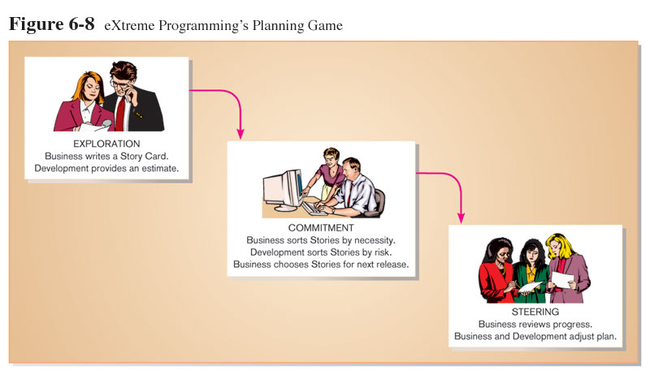
The Planning Game from eXtreme Programming

Slide 32
Requirements determining using Agile Methodologies
The planning game from extreme programming: (phases)
Exploration, business create story cards, development with an estimation of how long it would take to implement.
Commitment, sort the story cards and split them to essential, not essential, and nice to have.
Steering, to see how the development process is progressing.
The planning game is followed by iteration planning game, played by programmers.
7.32

